Slide 1
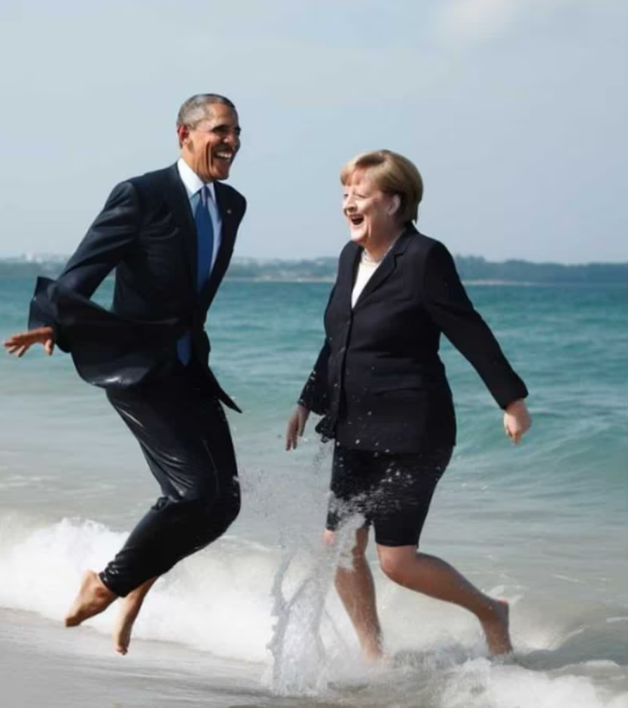
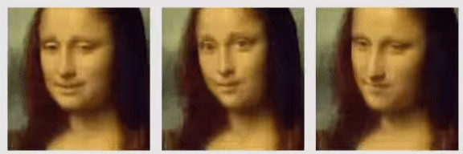
Artificial Facial Detection: Separating Real Faces from the Artificially Generated
Egor Zakharov Skolkovo Institute of Science
Udhbhav Gupta & Ante Tonkovic-Capin
@julian_ai_art/Instagram

Slide 2
Introduction - AI Fueled Arms Race
Technology for creating artificially generated images, also known as ‘Deep Fakes’, has become increasingly sophisticated.
Breakthroughs in artificial generation lead to new efforts to identify and detect forgeries, leading to an arms race in the field between generation and detection techniques
The potential for malicious use and spreading misinformation is immense
Our project aims to explore the potential of implementing an AI-generated detection system for facial images using a two-phase pipeline

Slide 3
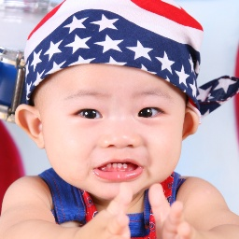
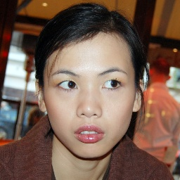

Real or Fake?

Slide 4

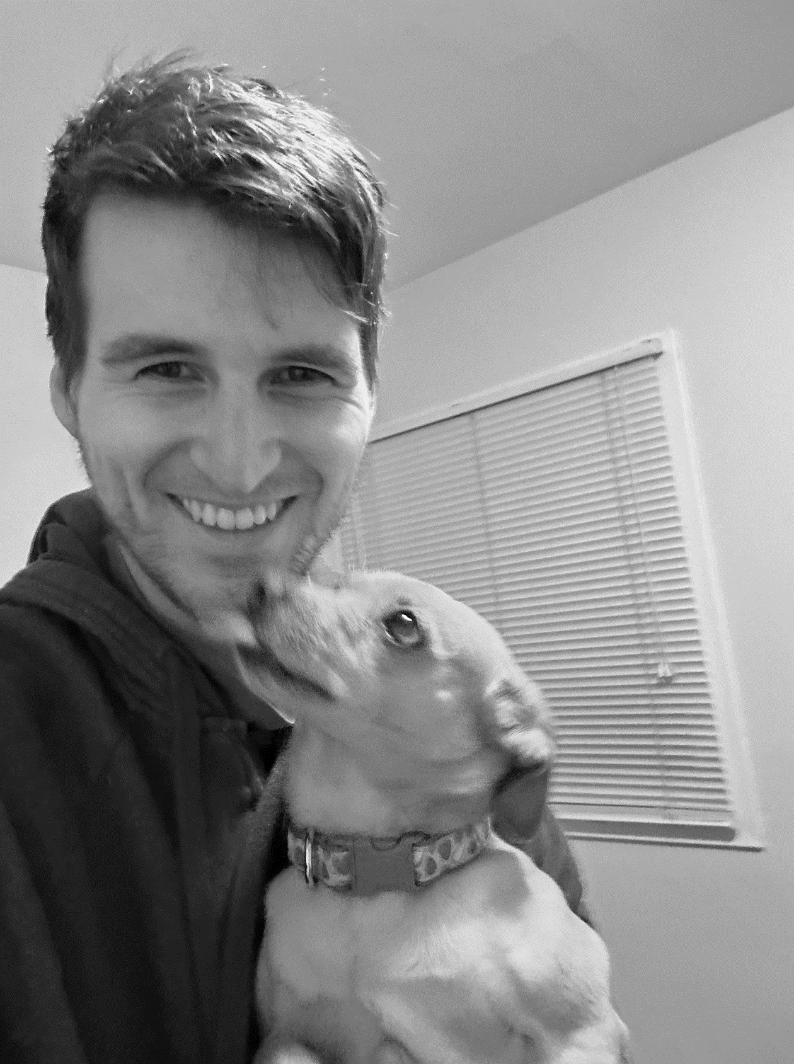


Defining Classification: What does it mean to be a “Real Face”
The face, as digitally represented, is considered real if it existed physically as a biological human at a moment in time and faithfully depicts the countenance, demeanor and position originally expressed by the digital representation such that the average observer’s prima facie impression closely reflects the reality of the moment captured digitally.
Right image generated using Stable Diffusion model at https://www.artguru.ai/ai-text-to-image-generator using left-most image as input

Slide 5
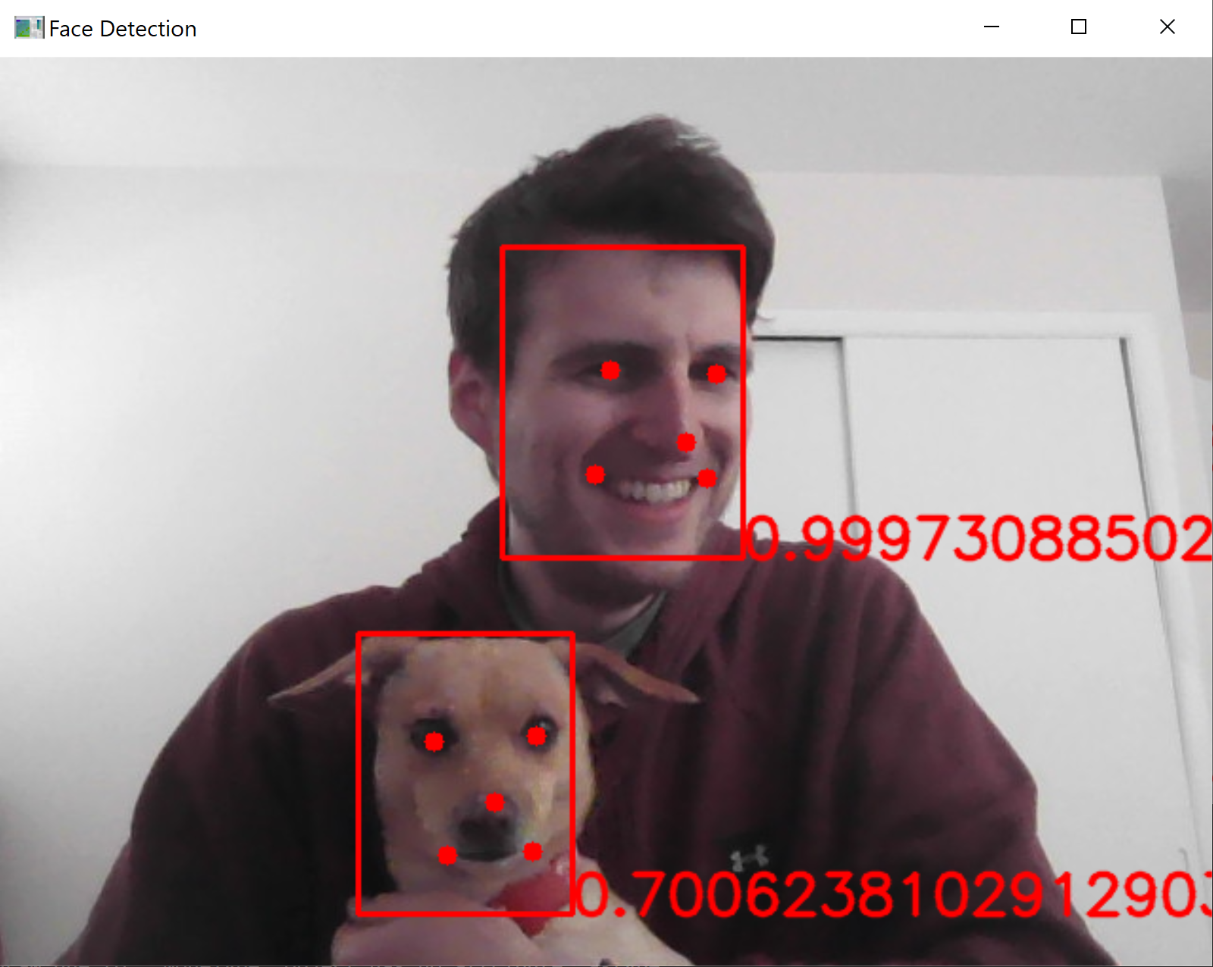
Facial Detection using MTCNN
Facial detection using Multitask Cascaded Convolutional Networks (MTCNN)
Extract using resultant bounding box and center on features
Resize and normalize as new image for input to CNN
Multitask comes from the cascading architecture with three tasks: Propose, Refine and Output
Zhang, K., Zhang, Z., Li, Z., and Qiao, Y. (2016). Joint face detection and alignment using multitask cascaded convolutional networks. IEEE Signal Processing Letters, 23(10):1499–1503.

Slide 6


Facial Detection and Extraction Example
Highest probability beyond specified threshold chosen as facial feature, extracted, resized, post-processed and normalized prior to input to CNN

Slide 7
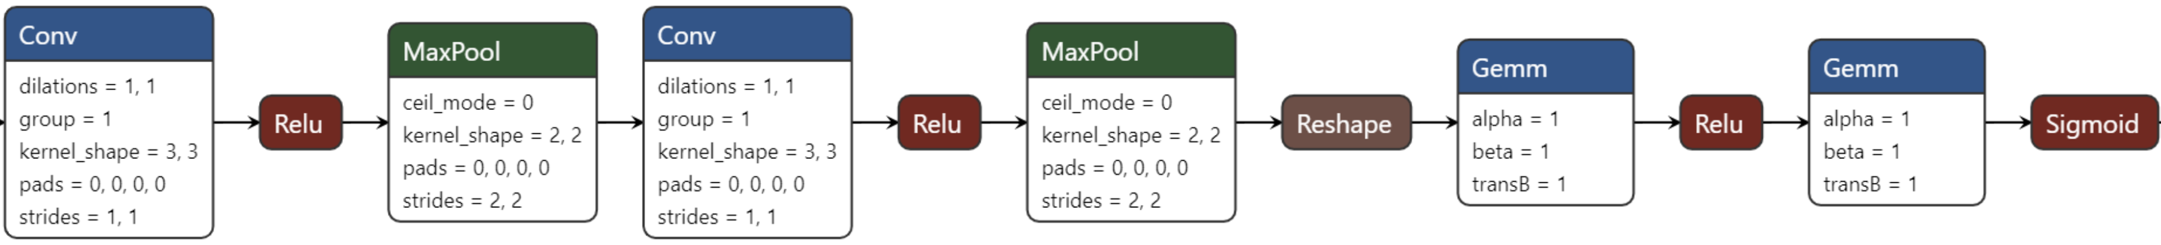
CNN Binary Classifier
Used dataset comprising 70,000 real faces from Flickr and 70,000 fake faces generated from the StyleGAN model, originally collected and provided by Nvidia
Facial image extracted from phase 1 passed through CNN comprised of two convolutional layers and two fully connected ones yielding output for binary classification
https://www.kaggle.com/datasets/xhlulu/140k-real-and-fake-faces

Slide 8
Best Results & Model Pipeline to Date:
Image
┌───────────┬─────────────────────┐
│ P1 Model │ MTCNN (0.5M params) │
│ P2 Model │ CNN (11.9M params) │
│ Results │ 8852 of 9998 │
│ Accuracy │ 88.54% │
│ Loss │ 0.4020 │
│ TP │ 4604 │
│ FP │ 751 │
│ FN │ 395 │
│ TN │ 4248 │
│ Precision │ 0.86 │
│ Recall │ 0.92 │
│ F1-Score │ 0.89 │
└───────────┴─────────────────────┘
MTCNN for face detection, bounding box regression and facial landmark localization tasks
Proposal-Net
Refine-Net
Output-Net
CNN for facial binary classification
Real or Fake
79x79x48
Conv: 3x3
MaxP: 2x2
38x38x128
Conv: 3x3
MaxP: 2x2
64x184832
64x1
σ(x)
FC1
FC2
MTCNN Paper: Long-Hua Ma, Hang-Yu Fan, Zhe-Ming Lu, Dong Tian (2020), Acceleration of multi-task cascaded convolutional networks. IET Image Process., 14: 2435-2441. https://doi.org/10.1049/iet-ipr.2019.0141

Slide 9
Exploratory Results & Various Approaches
Initially explored a couple different datasets and models, including pretrained CNNs for classification
┌────────────┬────────────┬────────┬────────────┬───────────┬──────────┐
│ Model │ Parameters │ Epochs │ Learn Rate │ Dataset │ Accuracy │
├────────────┼────────────┼────────┼────────────┼───────────┼──────────┤
│ vit-l-32 │ 306.5M │ 20 │ 5e-3 │ StyleGAN │ 50.18% │
│ vit-b-16 │ 86.6M │ 20 │ 1e-2 │ Photoshop │ 52.58% │
│ ffd-1k │ 1.6M │ 20 │ 3e-4 │ Photoshop │ 54.23% │
│ ffd-5k │ 1.6M │ 20 │ 3e-4 │ StyleGAN │ 77.90% │
│ ffd-5k │ 1.6M │ 80 │ 1e-4 │ StyleGAN │ 78.70% │
│ ffd-5k │ 1.6M │ 80 │ 2e-4 │ StyleGAN │ 79.30% │
│ ffd-5k │ 1.6M │ 50 │ 3e-4 │ StyleGAN │ 80.20% │
│ ffd-10k │ 11.8M │ 50 │ 2e-4 │ StyleGAN │ 83.30% │
│ ffd-50k │ 11.8M │ 10 │ 1e-4 │ StyleGAN │ 92.14% │
│ ffd+fe-10k │ 11.8M │ 50 │ 2e-4 │ StyleGAN │ 78.16% │
│ ffd+fe-50k │ 11.8M │ 10 │ 1e-4 │ StyleGAN │ 88.50% │
└────────────┴────────────┴────────┴────────────┴───────────┴──────────┘
Photoshop Dataset: https://www.kaggle.com/datasets/ciplab/real-and-fake-face-detection Computational Intelligence and Photography Lab, Yonsei University

Slide 10
Conclusion Placeholder

